Slide 1
Cloud Computing Fundamentals

Slide 2
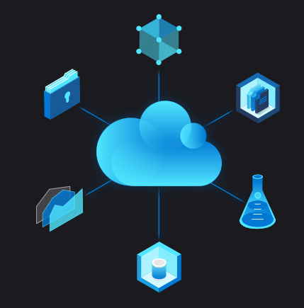
What is Cloud Computing
cloud computing is the delivery of computing services—including servers, storage, databases, networking, software, analytics, and intelligence—over the Internet (“the cloud”) to offer faster innovation, flexible resources, and economies of scale. You typically pay only for cloud services you use, helping lower your operating costs, run your infrastructure more efficiently and scale as your business needs change.

Slide 3
Benefits of Cloud Computing
Cloud computing is a big shift from the traditional way businesses think about IT resources. Here are seven common reasons organisations are turning to cloud computing services:
Cost - Cloud computing eliminates the capital expense of buying hardware and software and setting up and running on-site datacentres—the racks of servers, the round-the-clock electricity for power and cooling, the IT experts for managing the infrastructure. It adds up fast.
2. Global Scale - The benefits of cloud computing services include the ability to scale elastically. In cloud speak, that means delivering the right amount of IT resources—for example, more or less computing power, storage, bandwidth—right when it is needed and from the right geographic location.
3. Performance - The biggest cloud computing services run on a worldwide network of secure datacentre's, which are regularly upgraded to the latest generation of fast and efficient computing hardware. This offers several benefits over a single corporate datacentre, including reduced network latency for applications and greater economies of scale.

Slide 4
Benefits of Cloud Computing
Security- Many cloud providers offer a broad set of policies, technologies and controls that strengthen your security posture overall, helping protect your data, apps and infrastructure from potential threats.
Speed - Most cloud computing services are provided self service and on demand, so even vast amounts of computing resources can be provisioned in minutes, typically with just a few mouse clicks, giving businesses a lot of flexibility and taking the pressure off capacity planning.
Productivity - On-site datacentre's typically require a lot of “racking and stacking”—hardware setup, software patching, and other time-consuming IT management chores. Cloud computing removes the need for many of these tasks, so IT teams can spend time on achieving more important business goals.
Reliability - Cloud computing makes data backup, disaster recovery and business continuity easier and less expensive because data can be mirrored at multiple redundant sites on the cloud provider’s network.

Slide 5
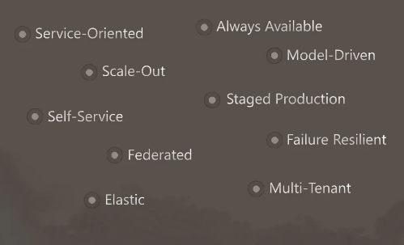
Generalized Cloud App Model

Slide 6

Microsoft Azure Data Center

Slide 7

Microsoft Azure Data Center

Slide 8
Types of Cloud Computing
Public Cloud - Public clouds are owned and operated by a third-party cloud service providers, which deliver their computing resources like servers and storage over the Internet. Microsoft Azure is an example of a public cloud. With a public cloud, all hardware, software and other supporting infrastructure is owned and managed by the cloud provider. You access these services and manage your account using a web browser.
Private Cloud - A private cloud refers to cloud computing resources used exclusively by a single business or organisation. A private cloud can be physically located on the company’s on-site datacentre. Some companies also pay third-party service providers to host their private cloud. A private cloud is one in which the services and infrastructure are maintained on a private network
Hybrid Cloud - Hybrid clouds combine public and private clouds, bound together by technology that allows data and applications to be shared between them. By allowing data and applications to move between private and public clouds, a hybrid cloud gives your business greater flexibility, more deployment options and helps optimise your existing infrastructure, security and compliance

Slide 9
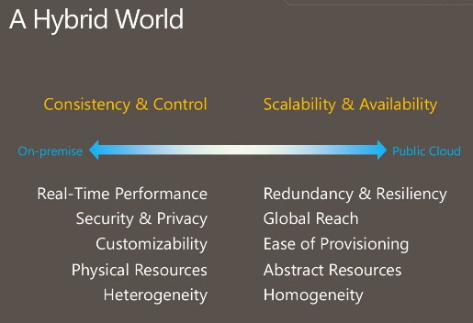
Hybrid Cloud

Slide 10
Types of Cloud Services
IaaS (Infrastructure as Service) - The most basic category of cloud computing services. With IaaS, you rent IT infrastructure—servers and virtual machines (VMs), storage, networks, operating systems—from a cloud provider on a pay-as-you-go basis.
PaaS (Platform as Service) - Platform as a service refers to cloud computing services that supply an on-demand environment for developing, testing, delivering and managing software applications. PaaS is designed to make it easier for developers to quickly create web or mobile apps, without worrying about setting up or managing the underlying infrastructure of servers, storage, network and databases needed for development.
Software as a service (SaaS)- Software as a service is a method for delivering software applications over the Internet, on demand and typically on a subscription basis. With SaaS, cloud providers host and manage the software application and underlying infrastructure and handle any maintenance, like software upgrades and security patching. Users connect to the application over the Internet, usually with a web browser on their phone, tablet or PC

Slide 11
Types of Cloud Computing
Serverless Computing: Overlapping with PaaS, serverless computing focuses on building app functionality without spending time continually managing the servers and infrastructure required to do so. The cloud provider handles the setup, capacity planning and server management for you. Serverless architectures are highly scalable and event-driven, only using resources when a specific function or trigger occurs.

Slide 12
Advantages of Cloud Computing
Lower Cost
Enhanced performance
Building of backup data, store data & recover data
Deliver Software on Demand
Analyse data
More scalability
More Throughput

Slide 13
Disadvantages
Vendor lock-in
Requires detailed cost estimation
Required planning of Cloud migration of Applications
Required new Skills

Slide 14
Azure Fundamentals

Slide 15
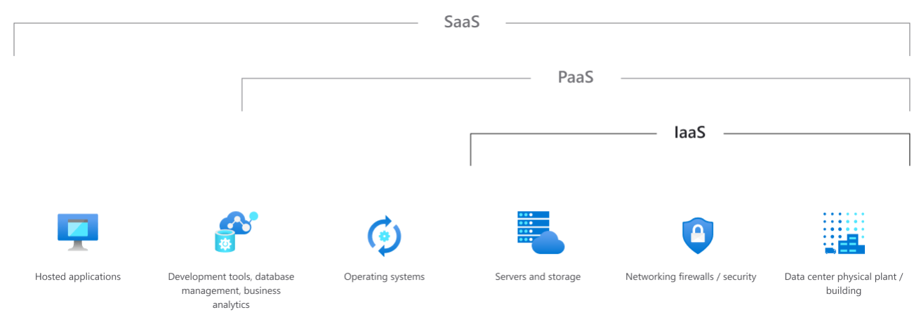
Azure Fundamentals
Azure IaaS, PaaS & SaaS Concepts

Slide 16
A lap around Azure Datacenter
Azure data centers are unique physical buildings – located all over the globe- that house a group of networked computer servers.
Azure composed of a globally distributed datacenter infrastructure supporting thousands of online services & spanning more than 100 highly secure facilities worldwide. Azure has 58 regions worldwide & is available in 140 countries/regions.
A region is set of datacenters interconnected via a massive & resilient network. The network includes content distribution, load balancing, redundancy & data link encryption by default for all Azure traffic within a region or travelling between regions.

Slide 17
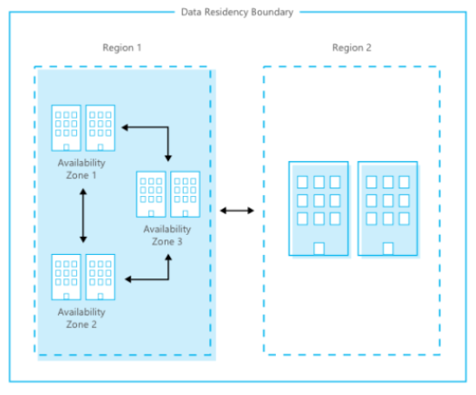
Datacenter Infrastructure
The Azure regions are organized into geographies ensures data residency, sovereignty, compliance & resiliency requirements are honored within geographical boundaries.
Availability zones are physically separate locations within an Azure region made up of one or more DC equipped with independent power, cooling & networking.

Slide 18
A lap around of Azure Availability Zones
Availability Zones which’re physically separate locations within a region consists of independent power, cooling & networking with 1000 miles apart.
Availability zones allow to run mission-critical applications with high availability & low latency replication.
Geographically distributed datacenters enables MSFT to be close to customers, to reduce network latency & allow for geo-redundant backup & failover.

Slide 19
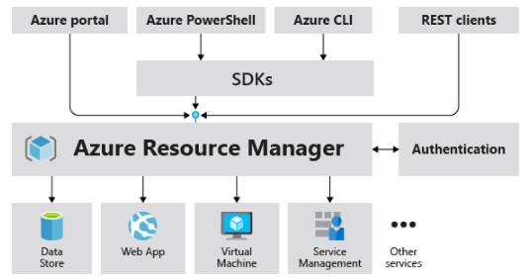
Overview of Azure Resource Manager
Azure Resource Manager is the deployment & management service for Azure which provides a management layer that enables you to create, update & delete resources in your Azure account.
The management features like access control, locks & tags can be used to secure & organize the resources after deployment.

Slide 20
The benefits of Azure Resource Manager
Manage your infrastructure through declarative templates rather than scripts.
Deploy, manage, and monitor all the resources for your solution as a group, rather than handling these resources individually.
Define the dependencies between resources so they're deployed in the correct order.
Apply access control to all services because Azure role-based access control (Azure RBAC) is natively integrated into the management platform.

Slide 21
Azure Resource Group Overview
A resource group is a container which holds related resources for an Azure solution which includes all of the resources for the solution or only those resources which you want to manage as a group.
Add resources that share the same lifecycle to the same resource group so you can deploy, update & delete them as a group.
The resource group stores metadata about the resources.

Slide 22
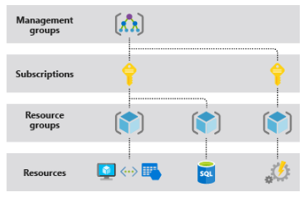
Azure Resource Group Scope
Azure provides four levels of scope: management group, subscription, resource groups & resources. The management settings can be applied at any of these levels of scope.
Lower levels inherit settings from higher levels.

Slide 23
Azure Resource Group Features
Resources in your resource group should share the same lifecycle through which you can deploy, update & delete them together.
Each resource can exist in only one resource group in a designated location.
You can add / remove a resource to a resource group at any time.
You can move a resource from one resource group to another group.
The resources in a resource group can be located in different regions than the resource group.

Slide 24
Azure Resource Providers & types
A service which supplies Azure resources. For e.g. a common resource provider is Microsoft.Compute which supplies the virtual machine resource.
Microsoft.Storage is another common resource provider. The Azure subscription must be registered for the resource provider. The registration step enables to maintain the principles of least privileges within the subscription.
You should have the permission to do the /register/action operation for the resource provider. The permission is included in the Contributor & Owner roles.

Slide 25
Overview of Azure Storage
An Azure Storage account consists of all your Azure Storage data objects : blobs, file share, queue, table, disks.
The storage account provides a unique namespace for your Azure Storage data which’s uniquely accessible from anywhere in the world over HTTP / HTTPS.
Data stored in Storage account is highly durable , secure, available & massively scalable.

Slide 26
Azure Storage Account Overview
An Azure Storage account consists of all your Azure Storage data objects : blobs, file share, queue, table, disks.
The storage account provides a unique namespace for your Azure Storage data which’s uniquely accessible from anywhere in the world over HTTP / HTTPS.
Data stored in Storage account is highly durable , secure, available & massively scalable.

Slide 27
Azure Role based access control
Azure Role based access control (RBAC) helps you to manage who has access to Azure resources based on accessibility.
Azure RBAC is an authorization system built on Azure resource manager which provides fine-grained access management of Azure resources.
It allows one user to manage VM in a subscription & another user to manage Azure Vnets.
Allow a DBA group to manage SQL databases in a subscription, manage all resources in a resource group, allows an application to access all resources in a resource group.

Slide 28
Types of Storage Account
Type of Storage account | Supported Storage service | Data redundancy options | Usage
Standard General Purpose V2 | Blob (Azure Data lake storage Gen2), Queue, Table, File share | LRS/GRS/RA-GRS/ZRS, ZRS/GZRS/RA-ZGRS | Standard storage account type for blob, file, queue, disks & tables.
Premium Block blobs | Blob storage + ADLS Gen2 | LRS , ZRS | High transaction rates, smaller objects / consistently low storage latency
Premium file share | Azure Files | LRS , ZRS | Enterprise/ high performance apps with SMB/NFS share
Premium Page blobs | Page blobs only | LRS | Premium storage for Page blobs.

Slide 29
What's Azure Service Health overview
Azure offers a suite of experiences to keep you informed about the health of your cloud resources. This information includes current and upcoming issues such as service impacting events, planned maintenance, and other changes that may affect your availability.
Azure Service Health is a combination of three separate smaller services.
Azure status informs you of service outages in Azure on the Azure Status page. The page is a global view of the health of all Azure services across all Azure regions. The status page is a good reference for incidents with widespread impact, but we strongly recommend that current Azure users leverage Azure service health to stay informed about Azure incidents and maintenance.
Service health provides a personalized view of the health of the Azure services and regions you're using. This is the best place to look for service impacting communications about outages, planned maintenance activities, and other health advisories because the authenticated Service Health experience knows which services and resources you currently use. The best way to use Service Health is to set up Service Health alerts to notify you via your preferred communication channels when service issues, planned maintenance, or other changes may affect the Azure services and regions you use.

Slide 30
Azure Databricks
Azure Databricks is optimized for Azure and tightly integrated with Azure Data Lake Storage, Azure Data Factory, Azure Synapse Analytics, Power BI and other Azure services to store all your data on a simple, open lakehouse and unify all your analytics and AI workloads.

Slide 31
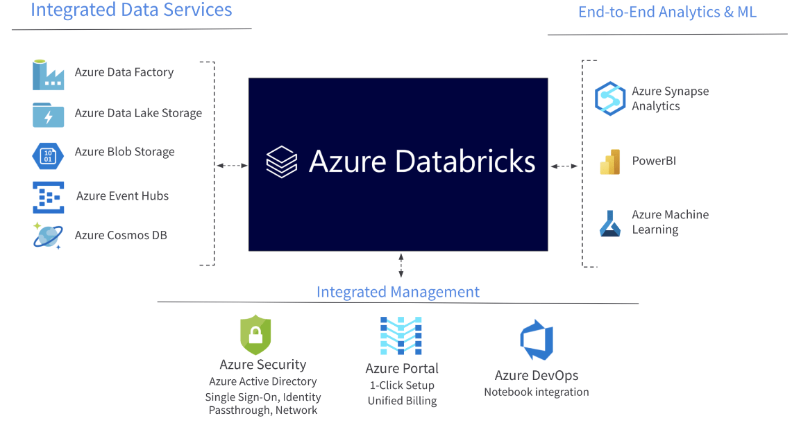
Azure Databricks

Slide 32
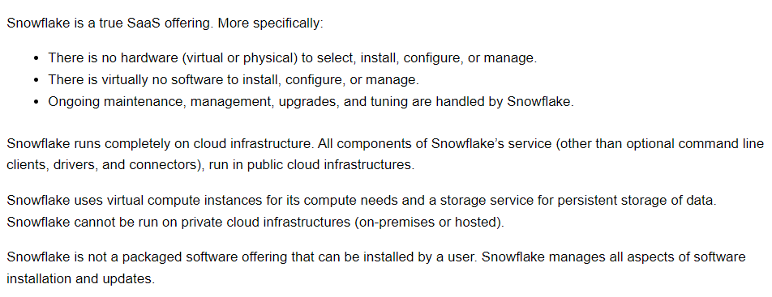
Snowflake

Slide 33
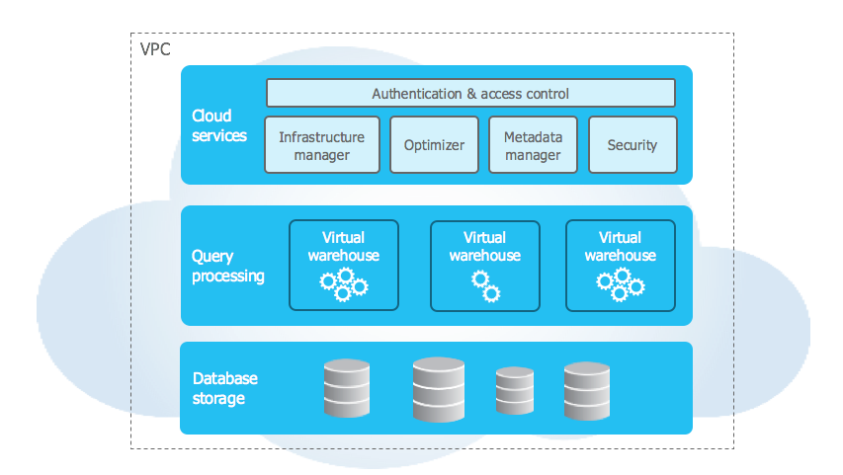
SnowFlake Architecture

